Slide 1
Number System
Unit Digit

Slide 2


Concept of Unit digit
Consider the following number: 5201862
 | 5 | 2 | 0 | 1 | 8 | 6 | 2
Place Value | Ten lacs / Million | Lacs | Ten Thousand | Thousand | Hundred | Tens | Unit
In multiplication and addition, to calculate the unit digit, we should focus only upon unit digit.
Unit digit of = 8. It is independent of the values of A, B, C, D and E.
Unit digit of AB2 + CDE4 = 6. It is independent of the values of A, B, C, D and E.

Slide 3
Concept of Unit digit
Similarly, while calculating tens digit, we should focus only upon the tens place and unit digit, and not on any digit to left hand side of tens digit
Tens digit of = cannot be calculated unless we have the value of B and E known to us.
Independent of the values of A, C and D

Slide 4
Concept of Unit digit
(Any digit)^{4n+1} = Same digit will be obtained
Example – Unit digit of 8⁵³ = 8, or, Unit digit of 7⁵³ = 7, or, Unit digit of 4⁹ = 4.
(Any odd digit)^{4n} – Unit digit obtained = 1, where n is any natural number.
Exception – if the odd digit = 5, then the unit digit obtained for 5^{any natural number} = 5.
(Any even digit)^{4n} – Unit digit obtained = 6, where n is any natural number.
if the even digit = 0, then the unit digit obtained for 0^{any natural number} = 0.
For unit digits 0, 1, 5 and 6, irrespective of the power, it will return the same digit.
E.g. Unit digit of (376) ^{n} = ……..6

Slide 5
Concept of Unit digit
Two questions that you need to ask yourself:
Is the unit digit of the number even / odd?
Is the power divisible by 4 or NOT?
Q1. Find the unit digit of 512²⁴⁸⁸
Unit Digit of 512²⁴⁸⁸ = Unit digit of 2⁸⁸
Unit Digit = 2 = Even
Power = 2488 → Divisible by 4
Hence unit digit = …..6

Slide 6
Concept of Unit digit
Q2. Find the unit digit of 537⁸¹⁵⁶
Unit Digit of 537⁸¹⁵⁶ = Unit digit of 7⁵⁶
Unit Digit = 7 = Odd
Power = 56 → Divisible by 4
Hence unit digit = …..1
Q3. Find the unit digit of 512²⁴⁸⁷
Unit Digit of 512²⁴⁸⁷ = Unit digit of 2⁸⁷
Unit Digit = 2 = Even
Power = 87 → NOT Divisible by 4
Unit digit of 2⁸⁷ = Unit digit of 2⁸⁴ x 2³ = ……..6 x 8 = ….8

Slide 7
Concept of Unit digit
Q4. Find the unit digit of 537⁸¹⁵⁴
Unit Digit of 537⁸¹⁵⁴ = Unit digit of 7⁵⁴
Unit Digit = 7 = Odd
Power = 54 → NOT Divisible by 4
Unit digit of 7⁵⁴ = Unit digit of 7⁵² x 7² = ……..1 x …9 = ….9

Slide 8
Practice Questions
Q5 (a) 784³⁴⁵
(b) 637⁵⁶⁹³⁴
(c) 81 x 82 x …………………….x 89
(d) 1! + 2! + 3! +………………….25!
(e) 734²³⁵ × 378⁴⁵⁷ × 2156⁵⁴⁵
(f) 246⁴⁵⁷ × 347³⁹⁷ × 378⁶²⁵⁴⁷³⁴
(e) ….4³⁵ × …8⁵⁷ × ….6⁴⁵ = (4³² × 4³) × (8⁵⁶ × 8¹) × (6⁴⁴ × 6⁰¹⁾ = (..6 x 4) x (…6 x 8) x (…6 x 6) = …4 x 8 x 6 = …2
(f) …6⁵⁷ × …7⁹⁷ × ..8³⁴

Slide 9
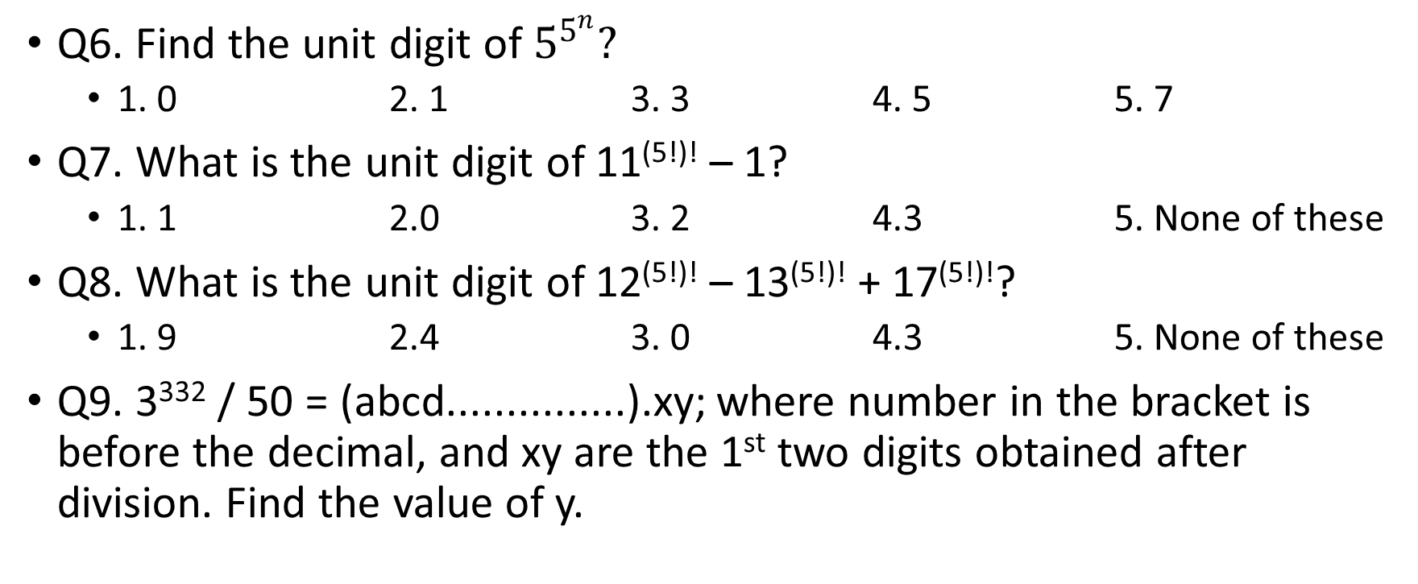
Some More Problems
Q6. Find the unit digit of $5^{5^{n}}?$
1. 0 2. 1 3. 3 4. 5 5. 7
Q7. What is the unit digit of 11^{(5!)!} – 1?
1. 1 2.0 3. 2 4.3 5. None of these
Q8. What is the unit digit of 12^{(5!)!} – 13^{(5!)!} + 17^{(5!)!}?
1. 9 2.4 3. 0 4.3 5. None of these
Q9. 3³³² / 50 = (abcd...............).xy; where number in the bracket is before the decimal, and xy are the 1st two digits obtained after division. Find the value of y.

Slide 10
Some more problems
Q10. What are the last two digits of 7²⁰⁰⁸?
a. 21 b. 61 c. 01 d. 41
Q11. The rightmost non-zero digits of the number 30²⁷²⁰ is
a.1 b.3 c.7 d.9
Q10. 7²⁰⁰⁸ ⁼ ⁽7⁴⁾⁵⁰² ⁼ ⁽…..01)⁵⁰²
a. 21 b. 61 c. 01 d. 41
Q11. 30²⁷²⁰ = 3^{2720 x} 10²⁷²⁰ = ….1 x ….0000000000000000 = ….1 (followed by 2720 zeroes).
a.1 b.3 c.7 d.9

